Slide 1
بسم الله الرحمن الرحيم
CSE605: Image Processing
Day 2

Slide 2
Agenda
What is a pixel?
Operations upon pixels
Pixel distributions: histograms
Histogram matching.

Slide 3
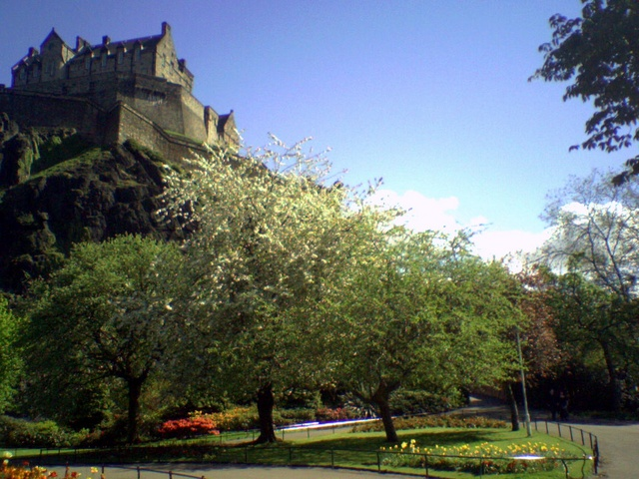
Image layout
I(0,0)
Y
I(0,N)
X
Image pixel location at (m,n), denoted by I(m,n)
I (M,0)
I (M,N)

Slide 4
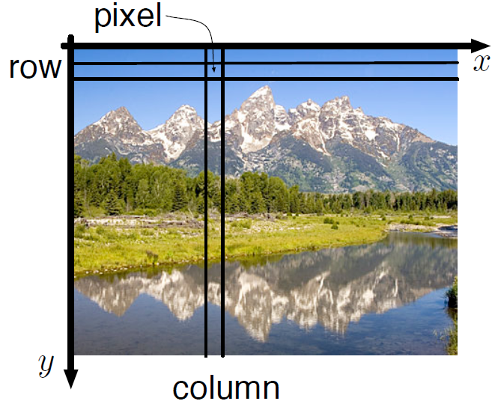
Image layout

Slide 5
RGB Color Encoding (Color Components)
The RGB color model is an additive model, in which red, green, and blue (RGB) light is combined in various ways to reproduce other colors.

Slide 6
RGB Color Encoding (Color Components)
im1=imread('1.png');
>> iRed=im1;
>> iRed(:,:,2:3)=0;
>> iGreen=im1;
>> iGreen(:,:,1)=0; iGreen(:,:,3)=0;
>> iBlue=im1;
>> iBlue(:,:,1:2)=0;
>> subplot(1,4,1), imshow(iRed); %Display 1st image
>> subplot(1,4,2), imshow(iGreen); %Display 2nd image
>> subplot(1,4,3), imshow(iBlue); %Display 3th image
>> subplot(1,4,4), imshow(im1); %Display 4th image

Slide 7
RGB Color Encoding (Color Components)

Slide 8
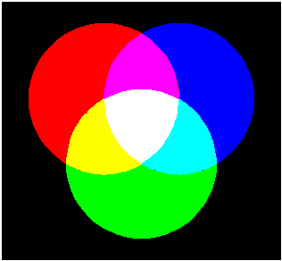
Color Images
R
M
B
W
Y
C
G
Mixtures of Light: Additive Primaries

Slide 9
B
B
G
G
R+G+B
R+G+B
R
R
B
B
G
G
R+G+B
R+G+B
R
R
B
B
G
G
R+G+B
R+G+B
R
R

Slide 10
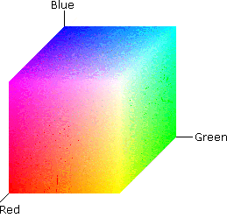
RGB Color Space

Slide 11
Pixel Connectivity
c
(r-1,c-1)
(r-1,c)
(r-1,c+1)
r
(r,c-1)
(r,c)
(r,c+1)
(r+1,c-1)
(r+1,c)
(r+1,c+1)

Slide 12
What is a pixel?
Pixel: The elements of a digital image.
Pixels

Slide 13
What is a pixel?
The word pixel is an abbreviation of ‘picture element ’. Indexed as an (y ; x) or row-column (r ; c) location from the origin of the image, it represents the smallest, constituent element in a digital image and contains a numerical value which is the basic unit of information within the image at a given spatial resolution and quantization level.

Slide 14
What is a pixel?
Commonly, pixels contain the colour or intensity response of the image as a small point sample of coloured light from the scene.

Slide 15
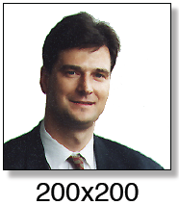
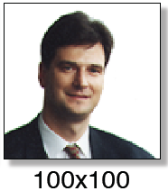
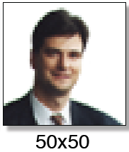
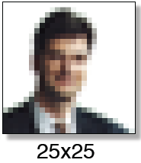
Digital Images and Pixels
Digital image: discrete samples f [x,y] representing continuous image f (x,y)!
Each element of the 2-d array f [x,y] is called a pixel or pel (from “picture element“)!

Slide 16
How many bits per pixel?

Slide 17
Operations upon pixels?
Arithmetic operations on images
Basic arithmetic operations can be performed quickly and easily on image pixels for a variety of effects and applications.
Image addition and subtraction

Slide 18
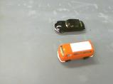
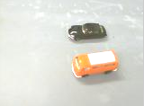
Operations upon pixels?
Image addition and subtraction
Contrast adjustment Adding a positive constant value C to each pixel location increases its value and, hence, its brightness.

Slide 19
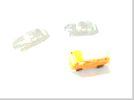
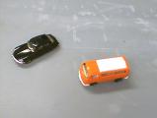
Operations upon pixels?
Image addition and subtraction
Blending Adding images together produces a composite image of both input images. This can be used to produce blending effects using weighted addition.
+

Slide 20
Ex 3.1: Matlab code What is happening?
%Read in image
A=imread(‘cameraman.tif)
%Display image
subplot(1,2,1), imshow(A);
%Add 100 to each pixel value in image A
B = imadd(A, 100);
%Display result image B
subplot(1,2,2), imshow(B);

Slide 21
Ex 3.2 Matlab code What is happening?
A=imread('cola1.png'); %Read in 1st image
B=imread('cola2.png'); %Read in 2nd image
subplot(1,3,1), imshow(A); %Display 1st image
subplot(1,3,2), imshow(B); %Display 2nd image
Output= imsubtract(A, B); %Subtract images
subplot(1,3,3), imshow(Output); %Display result
Output2= imabsdiff(A, B); %Subtract images

Slide 22
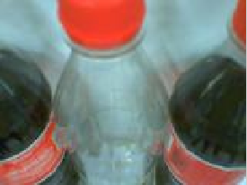
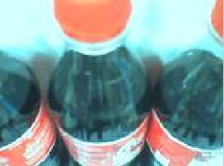
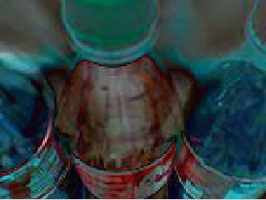
Ex 3.2 Matlab code What is happening?

Slide 23
Operations upon pixels?
Logical operations on images
We can perform standard logical operations between images such as NOT, OR, XOR and AND. In general, logical operation is performed between each corresponding bit of the image pixel representation (i.e. a bit-wise operator).

Slide 24
Operations upon pixels?
Logical operations on images
NOT (inversion) This inverts the image representation. In the simplest case of a binary image, the (black) background pixels become (white) foreground and vice versa. For greyscale and colour images, the procedure is to replace each pixel value I_{input}(i; j) as follows:

Slide 25
Operations upon pixels?
Logical operations on images
Where MAX is the maximum possible value in the given image representation. Thus, for an 8-bit grey-scale image (or for 8-bit channels within a colour image), MAX=255.

Slide 26
Operations upon pixels?
Logical operations on images
OR/XOR LogicalOR (and XOR) is useful for processing binary-valued images (0 or 1) to detect objects which have moved between frames.
Binary objects are typically produced through application of thresholding to a grey-scale image..
AND Logical AND is commonly used for detecting differences in images, highlighting target regions with a binary mask or producing bit-planes through an image, as discussed in Section 1.2.1.

Slide 27
Reading:
3.3 Point-based operations on images

Slide 28
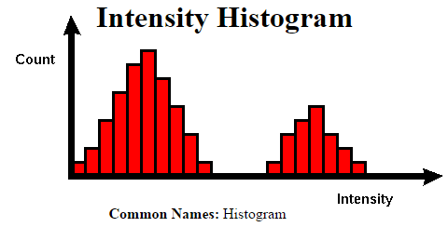
Pixel distributions: histograms

Slide 29
Pixel distributions: histograms
Histogram is a graph showing the number of pixels in an image at each different intensity value found in that image. For an 8-bit grayscale image there are 256 different possible intensities, and so the histogram will graphically display 256 numbers showing the distribution of pixels amongst those grayscale values.

Slide 30
Pixel distributions: histograms
Histograms can also be taken of color images --- either individual histograms of red, green and blue channels can be taken, or a 3-D histogram can be produced, with the three axes representing the red, blue and green channels, and brightness at each point representing the pixel count.

Slide 31
Pixel distributions: histograms
Page 75-76

